Slide 1
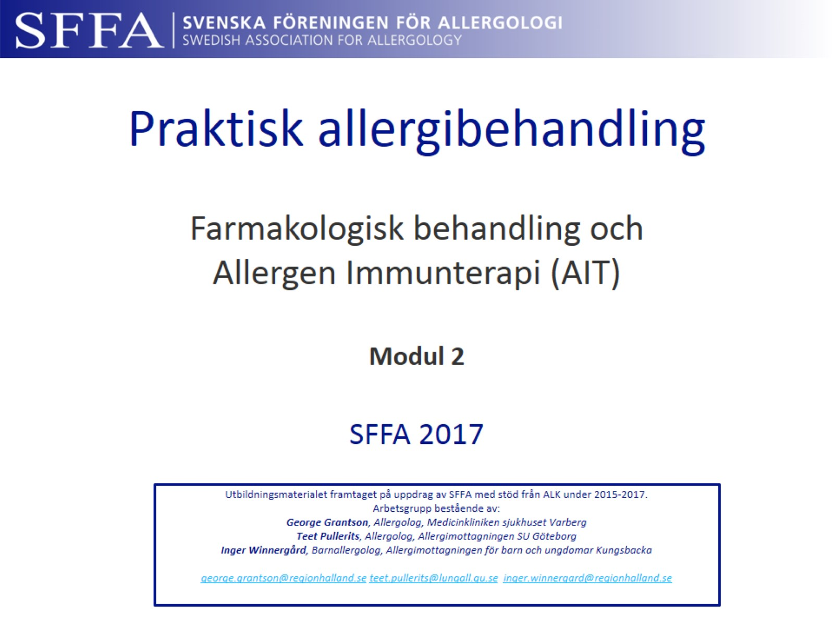
Praktisk allergibehandling Farmakologisk behandling och Allergen Immunterapi (AIT) Modul 2
Notes:
ALK har bidragit med finansiellt stöd för gruppen att träffas samt hjälpt till med tekniska lösningar i presentationen.

Slide 2
Praktisk allergibehandling

Slide 3
Behandlingar vid allergisk rinokonjunktivit

Slide 4
Behandlingsmål

Slide 5
Notes:
Schematisk bild för att kunna föra ett resonemang om vara olika läkemedel har sin verkan.

Slide 6
Rinitbehandling enligt ARIA -Översatt till svensk behandlingsalgoritm
Notes:
ARIA dokumentet översatt till Svensk version.

Slide 7
Samtidig astma bör utvärderas

Slide 8
Astmabehandling

Slide 9
Epidemiologi

Slide 10
Diagnostik

Slide 11
Astmafenotyper

Slide 12
Mål med astmabehandling

Slide 13
Underhållsbehandling av astma

Slide 14
Underhållsbehandling av astma

Slide 15
Eksembehandling

Slide 16
Eksembehandling
Notes:
Sidan kan ses som ett diskussionsunderlag

Slide 17
Anafylaxi
Notes:
Frimärket är kopplat till historien om ”upptäkten” av anafylaxi av Paul Portier och Charles Richet vilka var bekanta med Prins Albert av Monaco.
På frimärket syns Prins Alberts båt där experimenten med skeppshunden Neptune gjordes. Denne inokulerades med gift från blåsmaneter vilken också ses på frimärket. Efter en längre tids uppehåll i behandlingen gavs hunden den sist tolererade mängden gift, men hunden avled och man myntade begreppet anafylaxi. Charles Richet fick senare Nobelpris för sitt arbete om anafylaxi.

Slide 18
Viktiga budskap

Slide 19
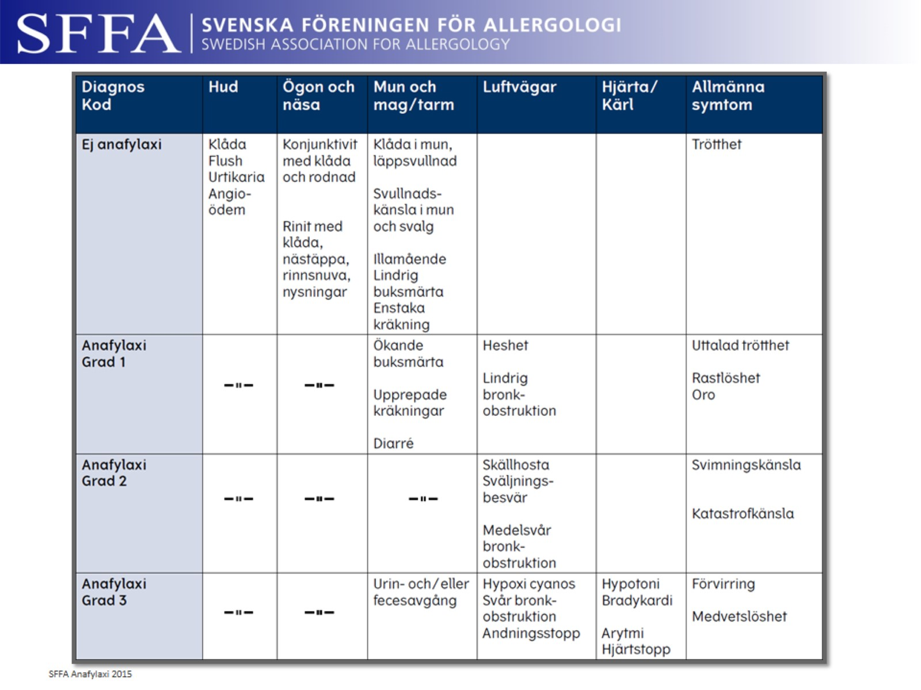

Slide 20
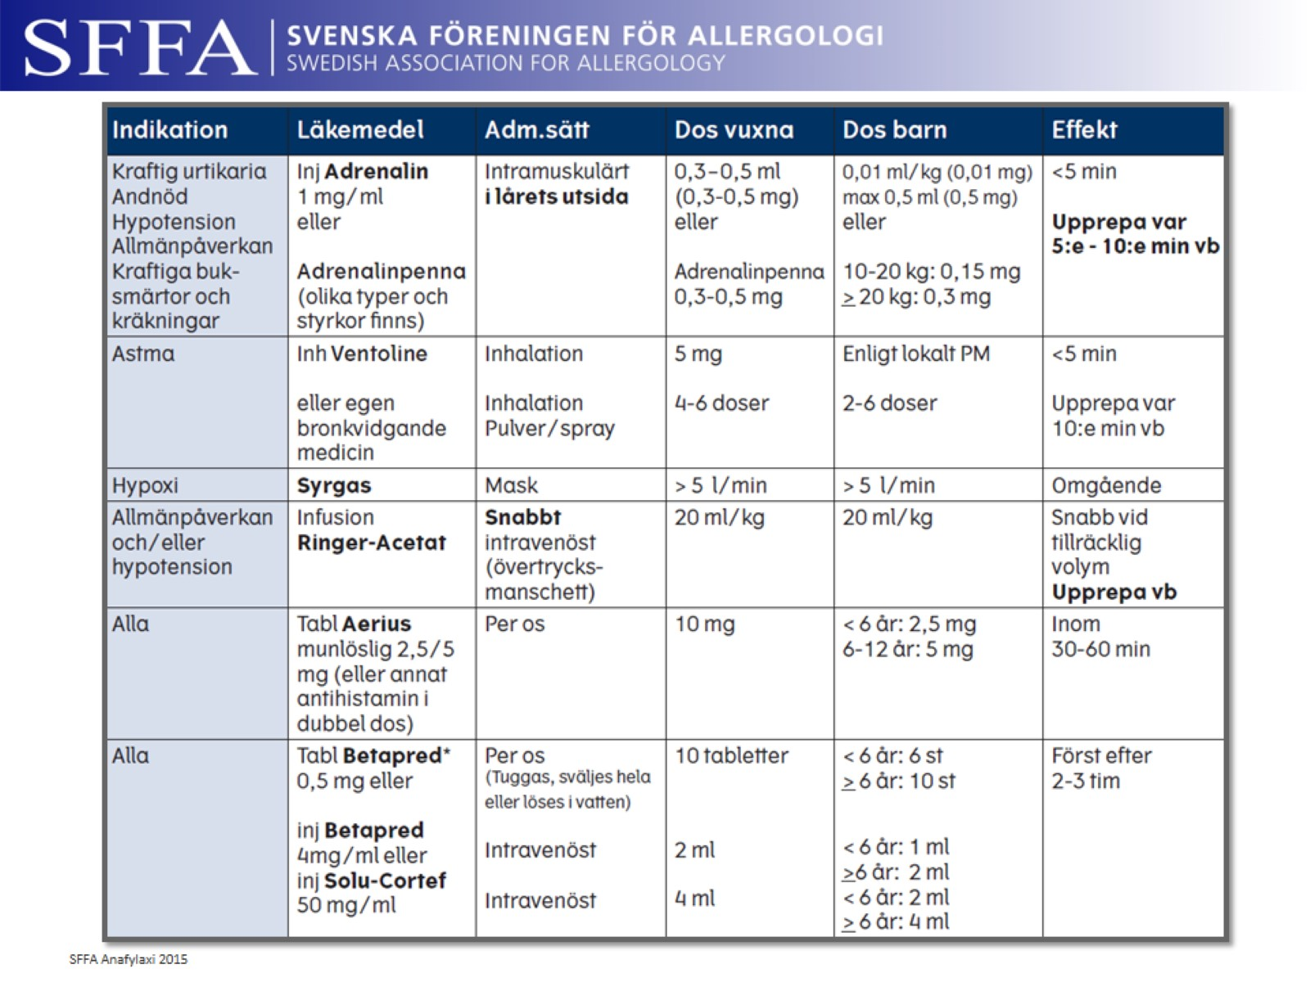

Slide 22
Notes:
Nuvarande adrenalinpennor på marknaden.

Slide 23
Allergen immunterapi (AIT)

Slide 24
Vad är AIT?

Slide 25
Notes:
Originalgraferna från artikeln i Lancet.
The numbers at the sides denote the resistance of the patient, given in terms of the strength of pollen extract, one drop of which was sufficient to excite a conjunctival reaction. The arrows indicate subcutaneous inoculations of pollen extract, quantities given in the units described in the text. Figs. 1 and 2 refer to one patient at different periods of treatment; Fig. 3 shows the response obtained after about a month’s treatment in another case; and Fig. 4 the early stages of treatment.

Slide 26
Kärt barn har många namn
Notes:
EAACI och WAO använder från och med 2015 vetenskapligt termen Allergen Immunterapi (AIT).
Denna delas sedan in i undergrupper. SCIT, SLIT-tabletter och SLIT-droppar.

Slide 27
AIT behandlar allergisk sjukdom¹

Slide 28
AIT i behandlingsstrategin

Slide 29
Göteborgsposten 2013
Notes:
Artikeln publicerades i Göteborgsposten 2013 och tar upp det stora behovet av AIT och sjukvårdspersonal som behärskar allergiområdet.
Bilden skall ses som ett diskussionsunderlag.

Slide 31
Verkningsmekanism AIT
Notes:
Allergener stimulerar Th2-celler att frisätta interleukiner (IL-4, IL-5, IL-13), som gynnar IgE-bildning och vävnadseosinofili. Detta framkallar en fortgående allergisk reaktion.
Allergenspecifik allergivaccination inhiberar Th2-svar genom att stimulera bildningen av reglerande T-celler (Treg) och Th1-celler.
Treg inhiberar direkt Th2-svar. Dessutom stimulerar både Treg och Th1-cell B-cell till produktion av blockerande antikroppar (IgG, IgG4 och IgA), som förhindrar bindningen mellan IgE och allergenet. Detta leder till mindre mastcellsaktivering och följaktligen mindre frisättning av mediatorer som histamin.

Slide 32
Subkutan immunterapi (SCIT)

Slide 33
Indikationer enligt SFFA

Slide 36
Tillgängliga allergen

Slide 37
Effekt på symtom med SCIT vid björkrinokonjunktivit
Notes:
Background: Birch pollen is a common allergen in northern, central, and eastern Europe. Earlier studies of specific immunotherapy using birch pollen extract were not placebo controlled or were only preseasonal. Long-term, placebo-controlled studies with subcutaneously administered standardized birch pollen extract are lacking. Objective: The aim of this study was to evaluate the effect of immunotherapy with birch pollen extract on airway symptoms and use of medication in adult birch pollen–allergic patients in a double-blind, placebo-controlled trial. Methods: Forty-nine patients with histories of birch pollen allergy from the upper and lower airways, positive skin prick test and conjunctival provocation test results, and in vitro specific IgE to birch pollen (Betula verrucosa) extract were included. Immunotherapy with birch pollen extract was given during 2 consecutive years in a double-blind, randomized, placebo controlled study. Clinical symptom scores from the upper and lower airways and use of rescue medication were registered throughout the pollen season. Results: Forty-six patients reached the maintenance dose and were maintained on that dose during the 2-year study. The median symptom scores during the 1997 and 1998 seasons were 1.3 and 2.6, respectively, in the specific immunotherapy group and 2.1 and 4.3, respectively, in the placebo group. The differences between the groups were significant (P = .05 in 1997 and P = .005 in 1998). The placebo group used significantly more rescue medication during both seasons than the specific immunotherapy group (P = .004 for 1997 and P = .004 for 1998). Conclusion: Specific immunotherapy with birch pollen extract is an effective and safe treatment for reducing clinical allergy symptoms and medication use in birch pollen–allergic patients during the pollen season. (J Allergy Clin Immunol 2002;109:777-83.)

Slide 38
Effekt på läkemedelsförbrukning med SCIT vid björkrinokonjunktivit

Slide 39
Preventive Allergy Treatment study (PAT) 10-årig studie som följer astmautveckling hos AIT-behandlade barn
Notes:
Background: 3-year subcutaneous specific immunotherapy (SIT) in children with seasonal allergic rhinoconjunctivitis reduced the risk of developing asthma during treatment and 2 years after discontinuation of SIT (5-year follow-up) indicating long-term preventive effect of SIT. Objective: We evaluated the long-term clinical effect and the preventive effect of developing asthma 7-years after termination of SIT. Methods: One hundred and forty-seven subjects, aged 16–25 years with grass and/or birch pollen allergy was investigated 10 years after initiation of a 3-year course of SIT with standardized allergen extracts of grass and/or birch or no SIT respectively. Conjunctival provocations were performed outside the season and
methacholine bronchial provocations were performed during the season and winter. Asthma was assessed by clinical evaluation. Results: The significant improvements in rhinoconjunctivitis and conjunctival sensitivity persisted at the 10-year follow-up. Significantly less actively treated
subjects had developed asthma at 10-year follow-up as evaluated by clinical symptoms [odds ratio 2.5 (1.1–5.9)]. Patients who developed asthma among controls were 24/53 and in the SIT group 16/64. The longitudinal treatment effect when adjusted for bronchial hyper-responsiveness and asthma status at baseline including all observations at 3, 5 and 10 years follow-up (children with or without asthma at baseline, n = 189; 511 observations) was statistically significant (P = 0.0075). The odds ratio for no-asthma was 4.6 95% CI (1.5–13.7) in favor of SIT. Conclusion: A 3-year course of SIT with standardized allergen extracts has shown long-term clinical effects and the potential of preventing development of asthma in children with allergic rhinoconjunctivitis up to 7 years after treatment. Clinical implication: Specific immunotherapy has long-term clinical effects and
the potential of preventing development of asthma in children with allergic rhinoconjunctivitis up to 7 years after treatment termination.

Slide 40
GRAZAX® Asthma Prevention Trial (GAP) Femårig studie som följer barn med gräspollenrinit vid inklusion för att studera astmautveckling. 3 års aktiv AIT-behandling med tablett + 2 års uppföljning efter avslutad behandling
Notes:
The probabilities are calculated from a Generalized Estimation Equation model (population based) that estimate the odds-ratio for GRAZAX® vs Placebo for having asthma symptoms and using asthma medication at any time during the two year follow-up period (OR=0.46). The number needed-to-treat is NNT=1/(probability for placebo – probability for GRAZAX®)
Important to state that the treatment effect (in terms of Odds-Ratio) is independent of age. All age groups have effect. The probability does however vary. Higher probability for developing asthma symptoms and use of asthma medication for the younger age group results in lower NNT.
Therefore early treatment start will prevent more children in disease progression from Rhinoconjunctivitis to having asthma symptoms and using asthma medication.

Slide 41
Notes:
Background: Children born to atopic parents are at increased
risk of sensitization to environmental allergens.
Objective: We sought to demonstrate proof of concept for oral
immunotherapy to high-dose house dust mite (HDM) allergen in
infancy in the prevention of allergen sensitization and allergic
diseases.
Methods: This was a prospective, randomized, double-blind,
placebo-controlled, proof-of-concept study involving 111 infants
less than 1 year of age at high risk of atopy (>2 first-degree
relatives with allergic disease) but with negative skin prick test
responses to common allergens at randomization. HDM extract
(active) and appropriate placebo solution were administered
orally twice daily for 12 months, and children were assessed
every 3 months. Coprimary outcomes were cumulative
sensitization to HDM and sensitization to any common allergen
during treatment, whereas development of eczema, wheeze, and
food allergy were secondary outcomes. All adverse events were
recorded.
Results: There was a significant (P 5 .03) reduction in
sensitization to any common allergen (16.0%; 95% CI, 1.7% to
30.4%) in the active (5 [9.4%]) compared with placebo (13
[25.5%]) treatment groups. There was no treatment effect on
the coprimary outcome of HDM sensitization and the secondary
outcomes of eczema, wheeze, and food allergy. The intervention
was well tolerated, with no differences between active and
placebo treatments in numbers or nature of adverse events.
Conclusion: Prophylactic HDM oral immunotherapy is well
tolerated in children at high heredity risk. The results met the
trial’s prespecified criteria for proof of concept in reducing
sensitization to any allergen; however, no significant preventive
effect was observed on HDM sensitization or allergy-related
symptoms.

Slide 42
AIT ur samhällsekonomiskt perspektiv

Slide 43
Praktisk SCIT-behandling

Slide 44
Sublingual immunterapi med tablett (SLIT)

Slide 45
SLIT-tablett

Slide 46
Hur många svarar på behandling med GRAZAX®?
Notes:
Background: Allergen immunotherapy (desensitization) by injection is effective for seasonal allergic rhinitis and has been shown to induce long-term disease remission. The sublingual route also has potential, although definitive evidence from large randomized controlled trials has been lacking.
Objective: The aim was to confirm the efficacy of a rapidly dissolving grass allergen tablet (GRAZAX, ALK-Abelló , Hørsholm, Denmark) compared with placebo in patients with seasonal rhinoconjunctivitis. Methods: A longitudinal, double-blind, placebo-controlled, parallel-group study that included 51 centers from 8 countries. Subjects were randomized (1:1) to receive a grass allergen tablet or placebo once daily. A total of 634 subjects with a history of grass pollen–induced rhinoconjunctivitis for at least 2 years and confirmation of IgE sensitivity (positive skin prick test and serum-specific IgE) were included in the study. Subjects commenced treatment at least 16 weeks before the grass pollen season, and treatment was continued throughout
the entire season. Results: The primary efficacy analysis showed a reduction of 30% in rhinoconjunctivitis symptom score (P < .0001) and a reduction of 38% in rhinoconjunctivitis medication score (P < .0001) compared with placebo. Side effects mainly comprised mild itching and swelling in the mouth that was in general well tolerated and led to treatment withdrawal in less than 4% of participants. There were no serious local side effects and no severe systemic adverse events. Conclusion: Sublingual immunotherapy with grass allergen tablets was effective in grass pollen–induced rhinoconjunctivitis. The tablet was well tolerated with minor local side effects. Clinical implications: The grass allergen tablet represents a safe alternative to injection immunotherapy suitable for home use. (J Allergy Clin Immunol 2006;118:434-440.)

Slide 47
Notes:
Background: The main aim of specific immunotherapy is sustained effect due to changes in the immune system that can be demonstrated only in long-term trials. Objective: To investigate sustained efficacy and disease modification in a 5-year double-blind, placebo-controlled trial, including 2 years of blinded follow-up after completion of a 3-year period of treatment, with the SQ-standardized grass allergy immunotherapy tablet, Grazax (Phleum pratense 75,000 SQ-T/2,800 BAU,* ALK, Denmark) or placebo. Methods: A randomized, double-blind, placebo-controlled, multinational, phase III trial included adults with a history of moderate-to-severe grass pollen–induced allergic rhinoconjunctivitis, with or without asthma, inadequately controlled by symptomatic medications. Two hundred thirty-eight participants completed the trial. End points included rhinoconjunctivitis symptom and medication scores, combined scores, asthma symptom and medication scores, quality of life, days with severe symptoms, immunologic end points, and safety parameters. Results: The mean rhinoconjunctivitis daily symptom score was reduced by 25% to 36% (P <.004) in the grass allergy immunotherapy tablet group compared with the placebo group over the 5 grass pollen seasons covered by the trial. The
Rhinoconjunctivitis DMS was reduced by20% to 45% (P<.022 for seasons 1-4; P 5.114 for season 5), and the weighted rhinoconjunctivitis combined score was reduced by 27% to 41% (P <.003) in favor of active treatment. The percentage of days with severe symptoms during the peak grass pollen exposure was in all seasons lower in the active group than in the placebo group, with relative differences of 49% to 63% (P <.0001). Efficacy was
supported by long-lasting significant effects on the allergen specific antibody response. No safety issues were identified. Conclusion: The results confirm disease modification by SQ-standardized grass allergy immunotherapy tablet in addition to effective symptomatic treatment of allergic rhinoconjunctivitis. (J Allergy Clin Immunol 2012;129:717-725.)

Slide 48
Notes:
GINA update 2017:
“As an extra option in steps 3 and 4, add-on sublingual immunotherapy (SLIT) can now be considered in adult house dust mite sensitive patients with asthma and allergic rhinitis who have experienced exacerbations despite ICS treatment, provided FEV1 is > 70% predicted”
Reference
Global Initiative for Asthma. Revised 2017. Available at http://ginasthma.org/2017-gina-report-global-strategy-for-asthma-management-and-prevention/

Slide 51
Praktisk SLIT-tablettbehandling

Slide 52
Administrering

Slide 58
Praktiska råd till patienten

Slide 59
Vanliga biverkningar i kliniken*

Slide 61
Uppföljning viktig för följsamhet

Slide 62
Patientfall

Slide 63
Gräspollenallergisk kvinna
Notes:
Avvakta graviditeten.

Slide 64
Idrottande 12-åring
Notes:
Tablett att föredra.

Slide 65
Man 40 år
Notes:
Följa indikation (utvärdera symptomatisk behandling bättre) eller patientens önskemål?

Slide 66
Pojke 11 år
Notes:
Begynnande astma stärker indikation och man bör starta patienten snarast innan astman förvärras.
Dock är det ont om tid innan säsong. En kombination av 7 veckor björk samt tablett möjlig.

Slide 67
Flicka 15 år

